Slide 1
Using Genetic Algorithm as a meta heuristic for search algorithms
By: George Le

Slide 2
Genetic algorithm
Again, we utilized a genetic algorithm as a meta heuristic for search algorithms applied to a 2D graph.
Our genetic algorithm consisted of 50 generations with a population of 10 individuals that have 6 traits (for six search algorithms in alphabetical order).
Individuals were Boolean arrays.

Slide 3
Search algorithms
A*
Beam
BFS
DFS
Hill climbing
Uniform cost

Slide 4
Fitness Function
Scores were assigned to the search algorithms, the scores being heuristic values for the algorithms.
Scores were calculated based on the following metrics:
Optimality (Finds the true shortest path)
Completeness (Finds the goal)
Efficiency (Amount of nodes searched)
Space complexity (Max amount of nodes expanded)
We selected the fittest half of the current generation to live on to the next generation and select two individuals from that half to reproduce.

Slide 5
Genetic Operators
Crossover and Mutation on new “children” individuals
We used two point crossover and bit string mutation.
Future upgrades can be made (uniform crossover and gaussian mutation for int or float values)

Slide 6
Results of GA
The individual(s) with the highest average scores for their combination of search algorithms will be considered the fittest individual.
Individual is an array of Boolean values and can be parsed to determine which algorithms contributed to the highest average.

Slide 7
Expected data
Stores the filename of the problem
Stores the “best” solution(s) of the problem
Stores the name of the “best” algorithms

Slide 8
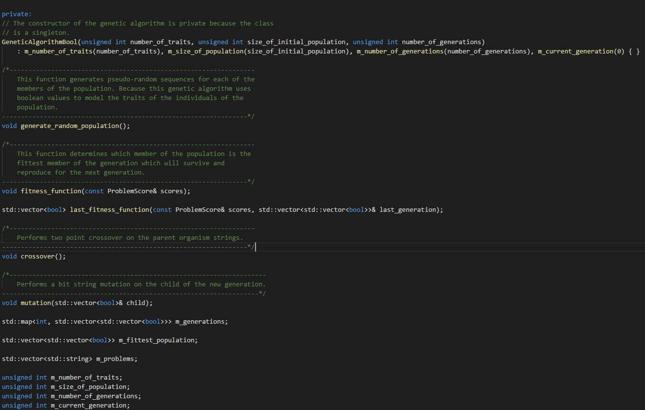
Implementation of GA
Singleton class
Reminder that an individual is a vector<bool>
A generation is therefore a vector<vector<bool>>
Problems are labelled by their filename.
This class is really only useful for traits that can be defined as Boolean values.

Slide 9
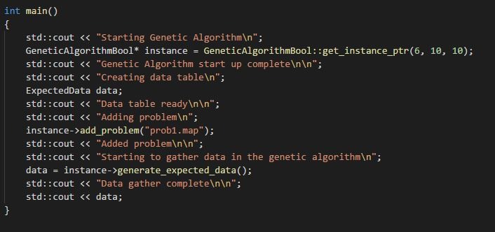
Usage In Driver
Future improvements can be accepting command line arguments, more modular design to allow for connection with other AI systems

Slide 10
FUTURE WORK
Inclusion of additional search algorithms (IDA, other hill climbing, greedy versions, genetic algorithm!, etc.)
Additional generations and population size can improve the GA. Repetition of the GA to generate expected data can ensure precision.
Can make GA a template to allow for any type of problem and its solver to be used with the GA class.
Generate expected data to train other AI systems such as artificial neural networks.
Given a different test file, can be compare to existing expected data to see if the same search problem has been searched before and can just produce an answer instead of wasting the time to generate a solution.
Can be extended to have 2D grids stacked on top of each other for verticality to allow for 3D search problems.

